Slide 1
Deep Q-Learning for Reducing Traffic Delay
Based on
Human-level control through deep reinforcement
learning
Volodymyr Mnih1*, Koray Kavukcuoglu1*, David Silver1*, Andrei A. Rusu1, Joel Veness1, Marc G. Bellemare1, Alex Graves1,
Martin Riedmiller1, Andreas K. Fidjeland1, Georg Ostrovski1, Stig Petersen1, Charles Beattie1, Amir Sadik1, Ioannis Antonoglou1, Helen King1, Dharshan Kumaran1, Daan Wierstra1, Shane Legg1 & Demis Hassabis1
ABHINAV SUNDERRAJAN

Slide 2
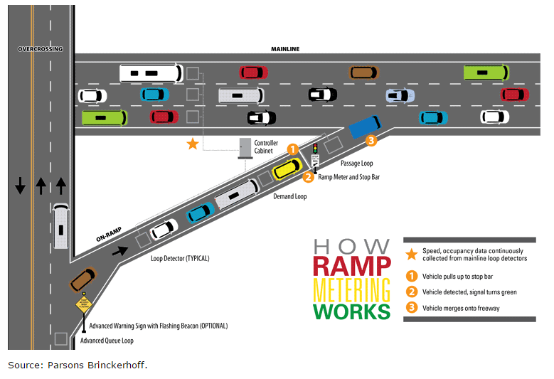
Ramp metering
Control the flow of vehicles along an on-ramp of an expressway using traffic lights to:-
Minimize delay along the main line expressway and the ramps.
Avoid shock waves due merging of vehicles.
Minimize accidents and collisions to increase safety.

Slide 3
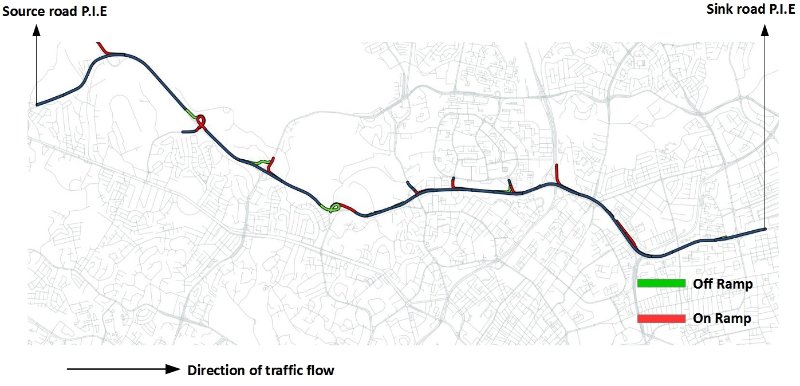
Environment
13 km stretch of P.I.E (Pan Island Expressway) in central Singapore with all on ramps and off ramps.

Slide 4
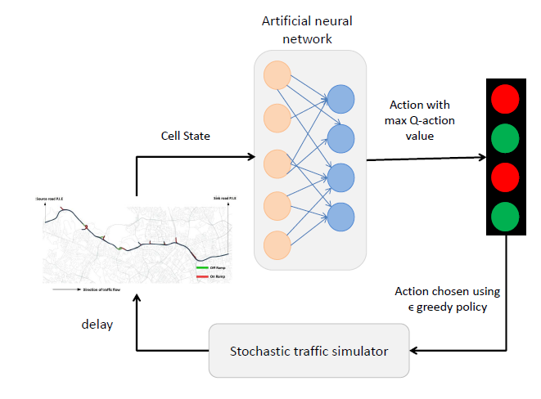
GOAL
Find a ramp metering policy which minimizes the total delay experienced by all vehicles over a simulated time horizon of K time-steps.

Slide 5
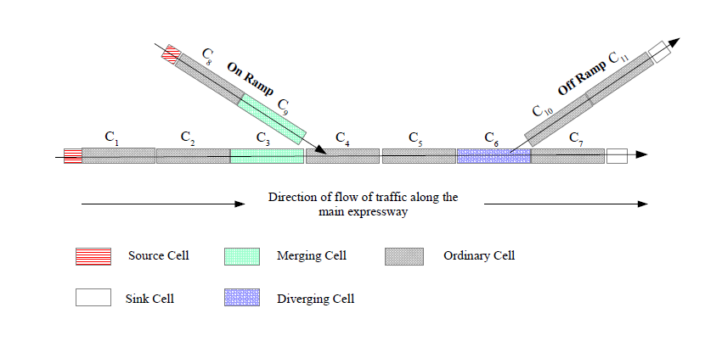
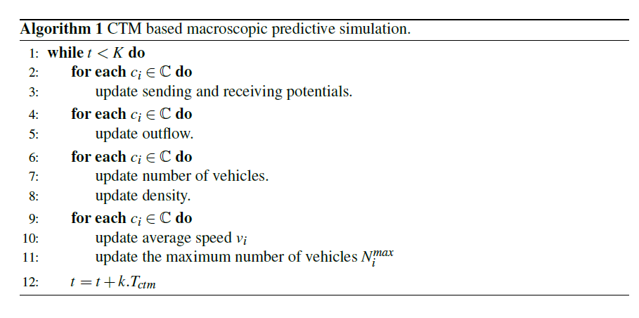
Traffic Emulator Model
Stochastic Cell transmission Model macroscopic traffic simulation of P.I.E section with all on off ramps
Total number of cells in the simulated stretch of the expressway is 212
https://www.researchgate.net/publication/303940227_SYMBIOTIC_TRAFFIC_SIMULATION_FRAMEWORK

Slide 6
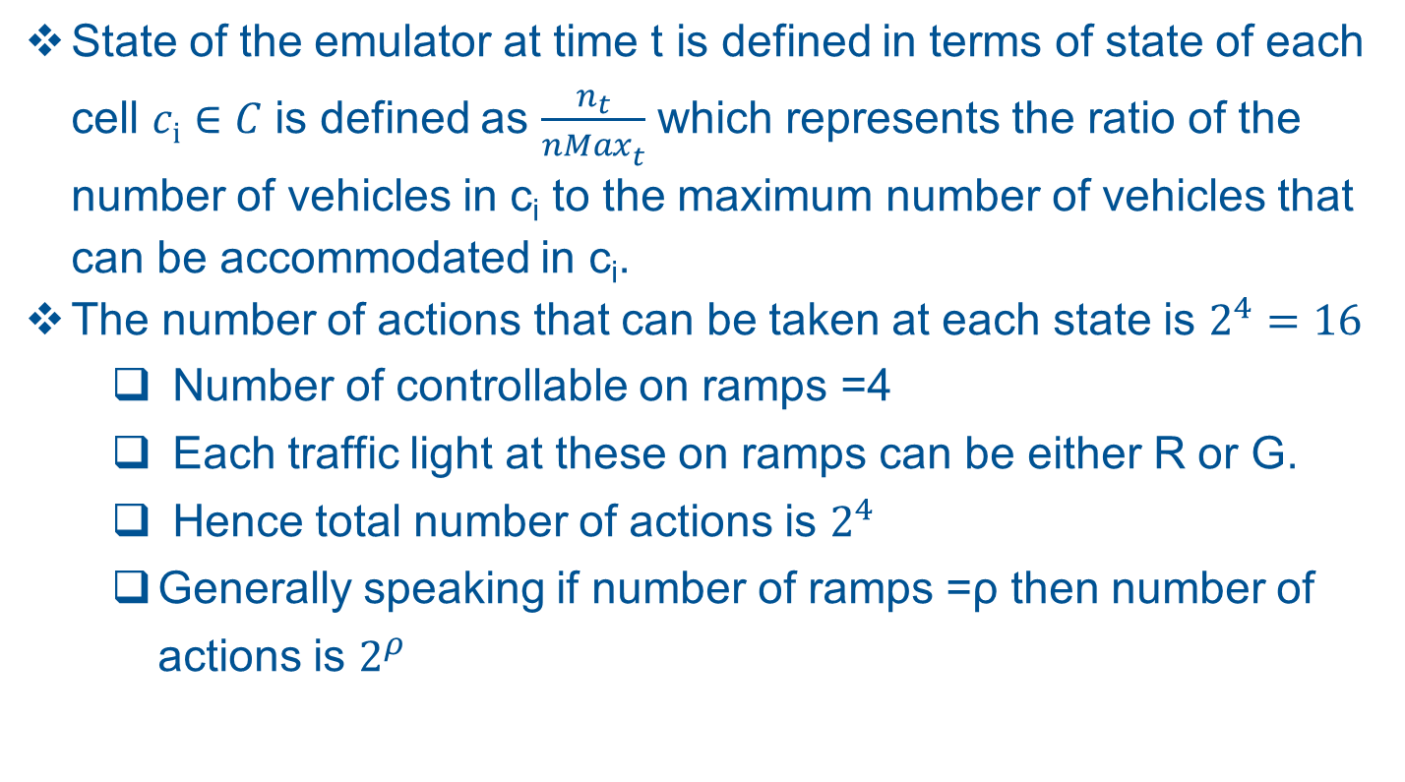
Traffic Emulator State and Action
State of the emulator at time t is defined in terms of state of each cell $ci∈C$ is defined as $\frac{n_{t}}{{nMax}_{t}^{}}$ which represents the ratio of the number of vehicles in c_{i} to the maximum number of vehicles that can be accommodated in c_{i}.
The number of actions that can be taken at each state is $2^{4}=16$
Number of controllable on ramps =4
Each traffic light at these on ramps can be either R or G.
Hence total number of actions is $2^{4}$
Generally speaking if number of ramps =ρ then number of actions is $2^{ρ}$

Slide 7
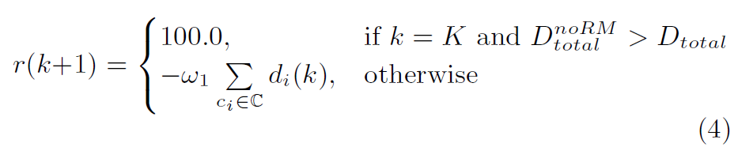
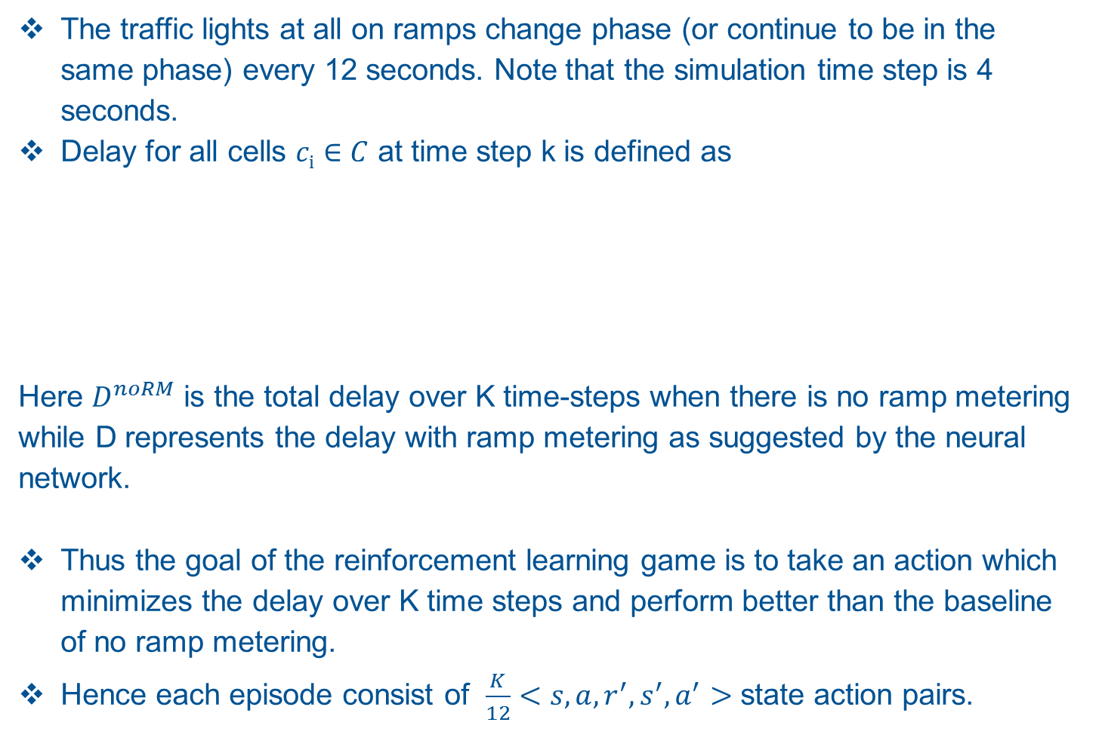
Traffic Emulator Reward
The traffic lights at all on ramps change phase (or continue to be in the same phase) every 12 seconds. Note that the simulation time step is 4 seconds.
Delay for all cells $ci∈C$ at time step k is defined as
Here $D^{noRM}$ is the total delay over K time-steps when there is no ramp metering while D represents the delay with ramp metering as suggested by the neural network.
Thus the goal of the reinforcement learning game is to take an action which minimizes the delay over K time steps and perform better than the baseline of no ramp metering.
Hence each episode consist of $\frac{K}{12}<s,a,r^{′},s^{′},a^{′}>$ state action pairs.
Notes:
Explain why you designed this kind of reward system.

Slide 8
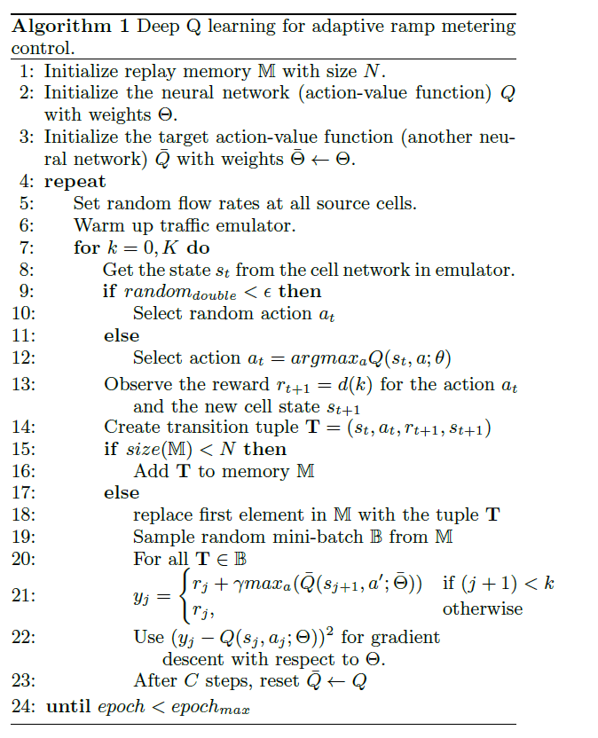
Training

Slide 9
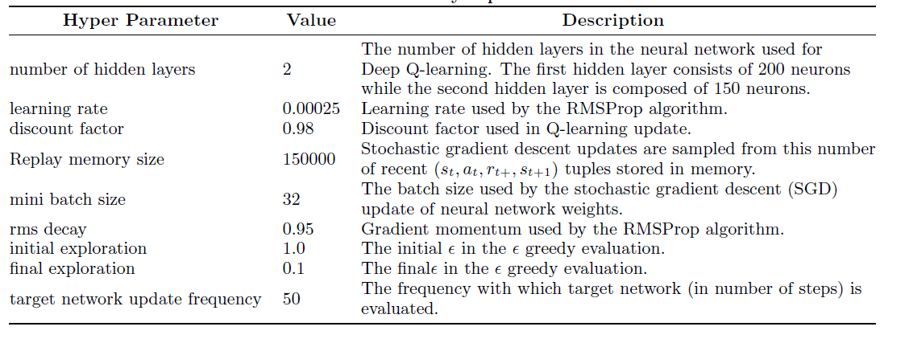
Hyper-parameters
Number of epochs trained=1000

Slide 10
Neural Network
MultiLayerConfiguration conf = new NeuralNetConfiguration.Builder()
.seed(random.nextLong())
.optimizationAlgo(OptimizationAlgorithm.STOCHASTIC_GRADIENT_DESCENT)
.iterations(1)
.activation("leakyrelu")
.weightInit(WeightInit.RELU)
.learningRate(learningRate)
.updater(Updater.RMSPROP)
.rmsDecay(0.9)
.regularization(true)
.l2(2.0e-4)
.list()
.layer(0,
new DenseLayer.Builder().nIn(numOfCells).nOut(204).activation("leakyrelu")
.weightInit(WeightInit.RELU).build())
.layer(1,
new DenseLayer.Builder().nIn(204).nOut(150).activation("leakyrelu")
.weightInit(WeightInit.RELU).build())
.layer(2,
new OutputLayer.Builder(LossFunction.MSE).activation("identity").nIn(150)
.nOut(numOfActions).build()).pretrain(false).backprop(true).build();

Slide 11
TESTING
Generate random flow at the source links with constant mean inter-arrival times.
Determine the net delay experienced by all vehicles with no ramp metering over K time steps.
Determine the net delay experienced by all vehicles with the ramp metering strategy determined by the trained neural network i.e. choose the action with the highest assigned probability by feeding forward the current state.
Compare and plot the results from steps 2 and 3.

Slide 12
RESULTS
Source Link ID | Mean IAT
30633 | 3800
82 | 1400
29310 | 1300
28946 | 1000
30790 | 1400
37980 | 1400
28595 | 1400
29152 | 1000
29005 | 1000
29553 | 1500
28613 | 1500
31991 | 800
PROOF OF Q-LEARNING
Action-Value Function
Without Ramp Metering | With Deep-RL based ramp metering
1026160 | 947915

Slide 13
RESULTS

Slide 14
RESULTS
Total delay over 1800 seconds
50 Random flow rates

Slide 15
CONCLUSION
The results how that deep reinforcement learning has promise for optimizing traffic flow through control mechanisms such a ramp metering.
A more suitable emulator (Cellular Automata based) is required to analyze and optimize the effect of other control mechanisms such as variable speed limits, adaptive cruise.
I have not found a single paper which uses Deep Q learning for traffic flow optimization and more specifically with ramp metering. This is the biggest contribution of this paper.

